Slide 1
Numpy
Almost every data science library is base on numpy
They are much more efficient that lists
Python library for creating n dimensional arrays
Ability to quickly broadcast functions

Slide 2
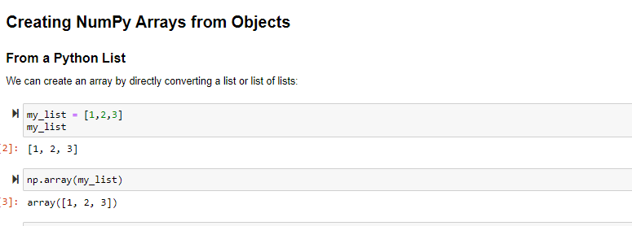

Slide 3
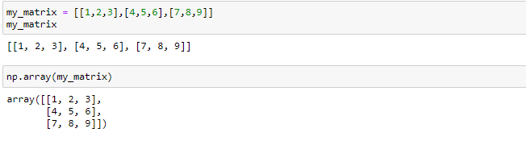

Slide 4
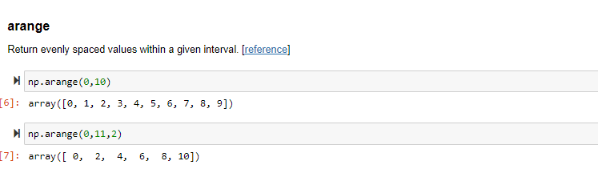

Slide 5
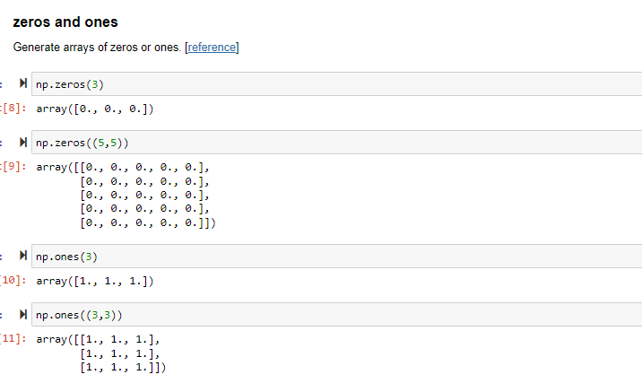

Slide 6
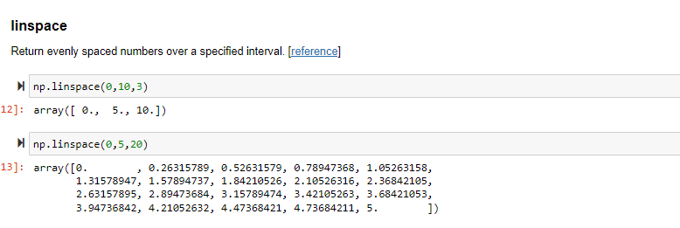
Difference between linspace and arange

Slide 7
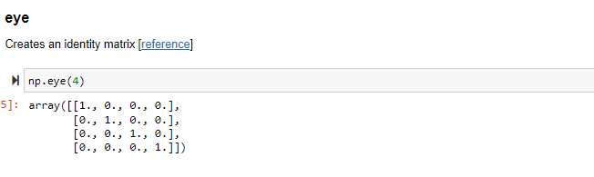
Identity matrix

Slide 8
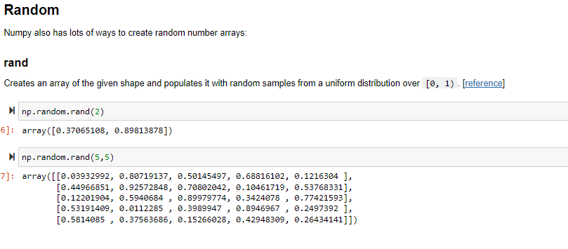

Slide 9
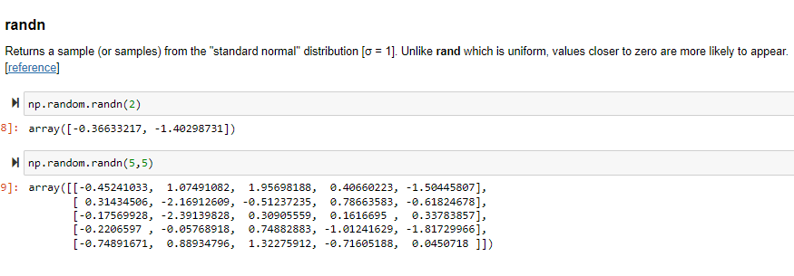

Slide 10
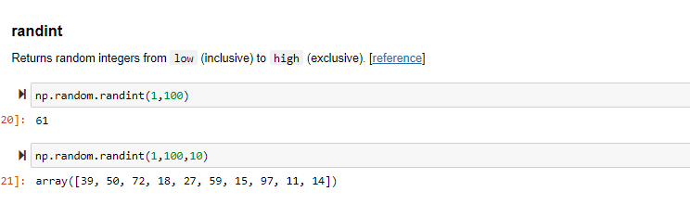

Slide 11
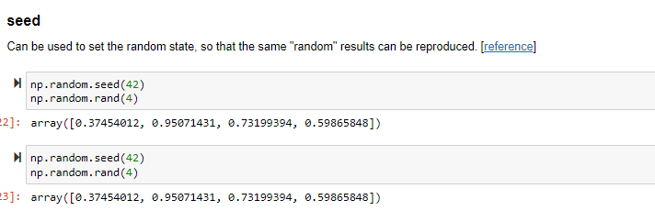

Slide 12
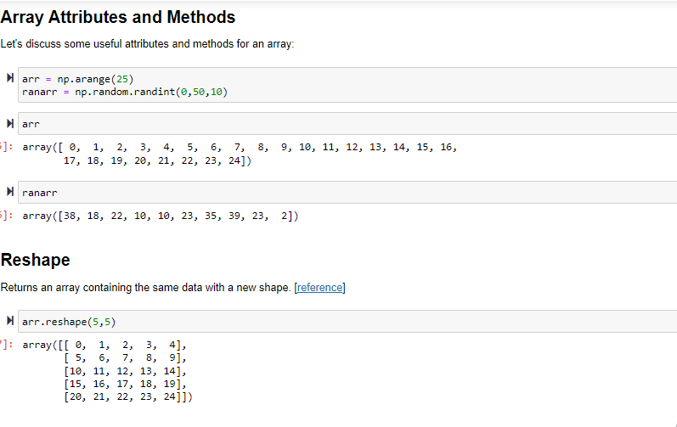

Slide 13
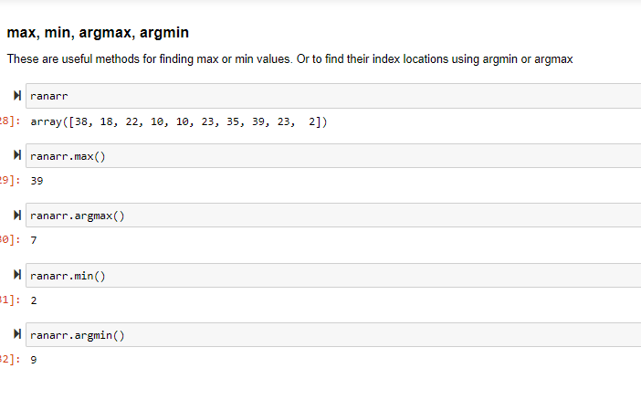

Slide 14
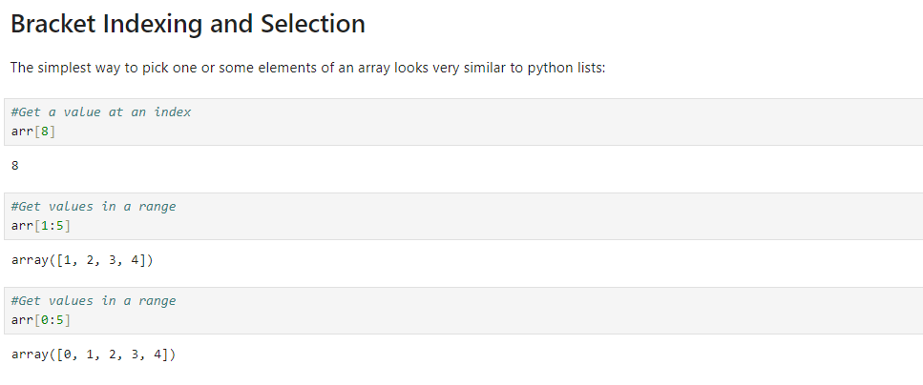
Bracket indexing and selection

Slide 15
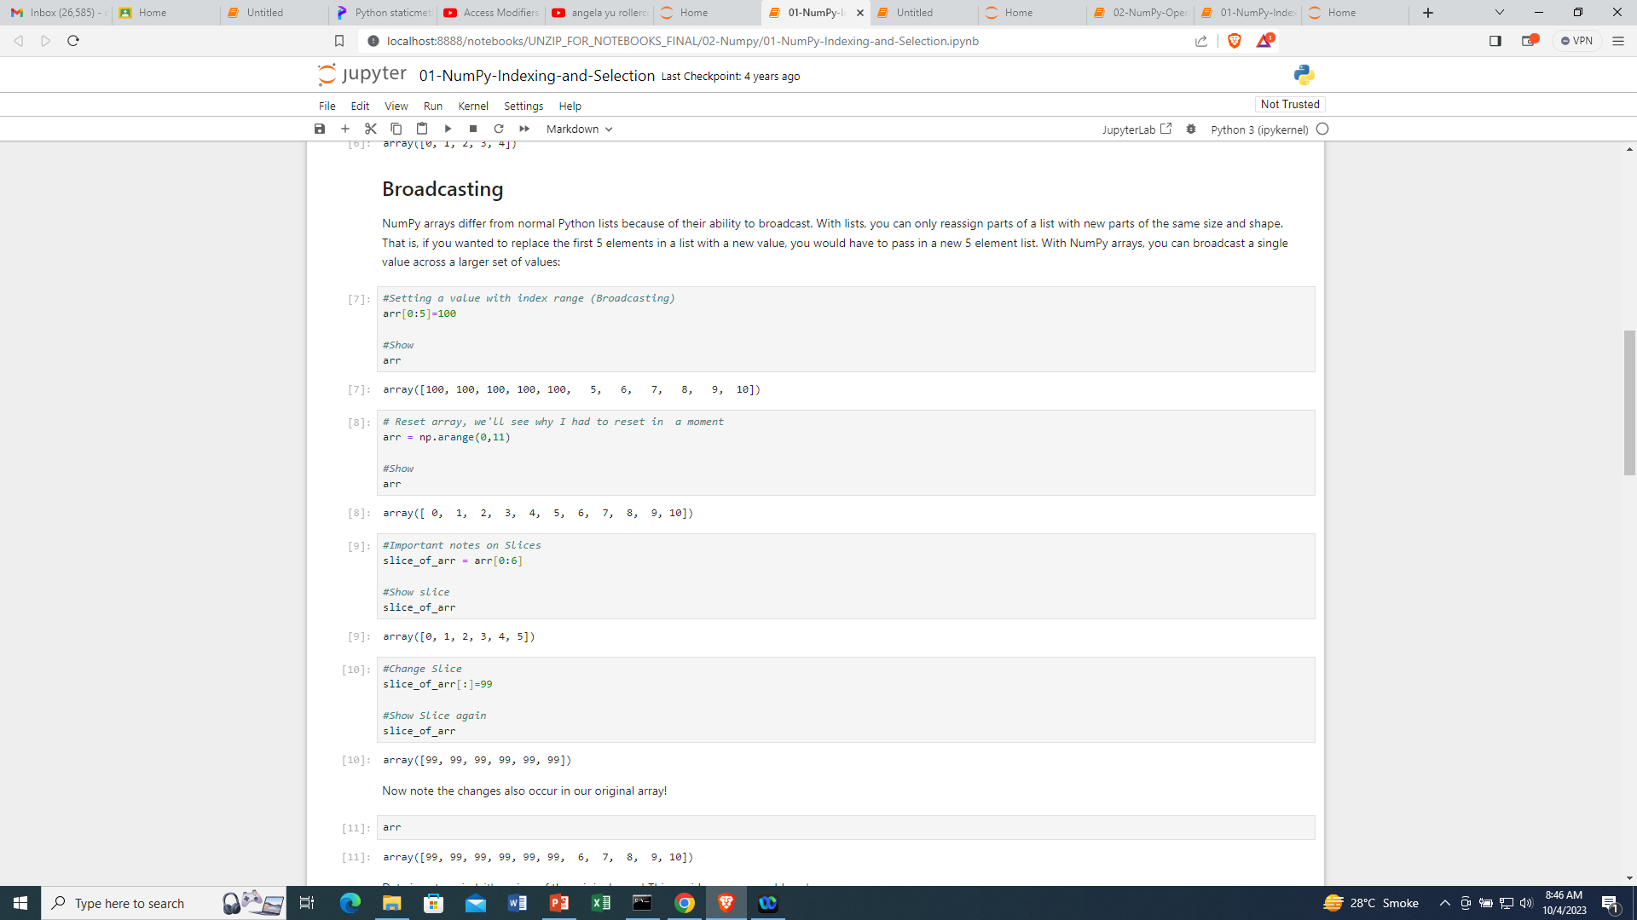

Slide 16
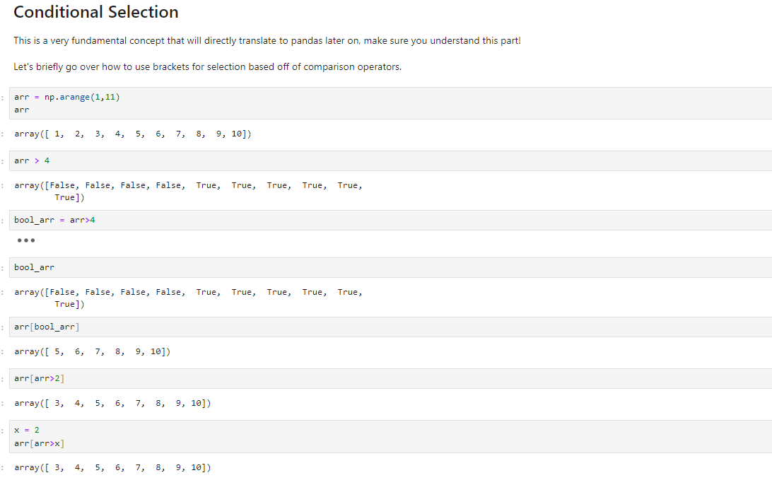

Slide 17
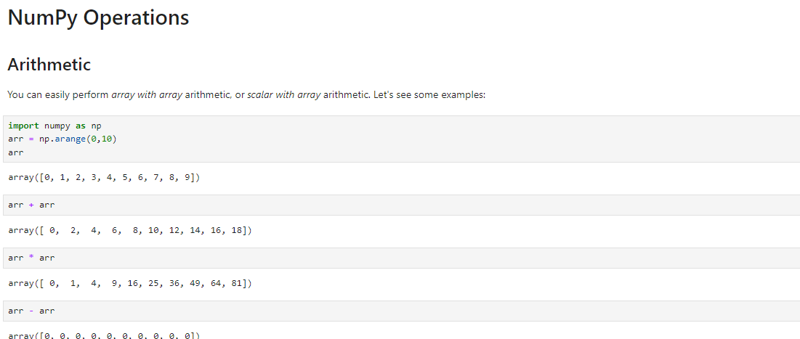
Numpy operations

Slide 18
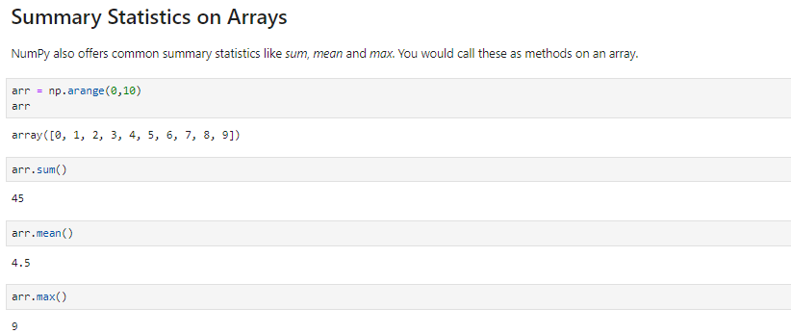

Slide 19
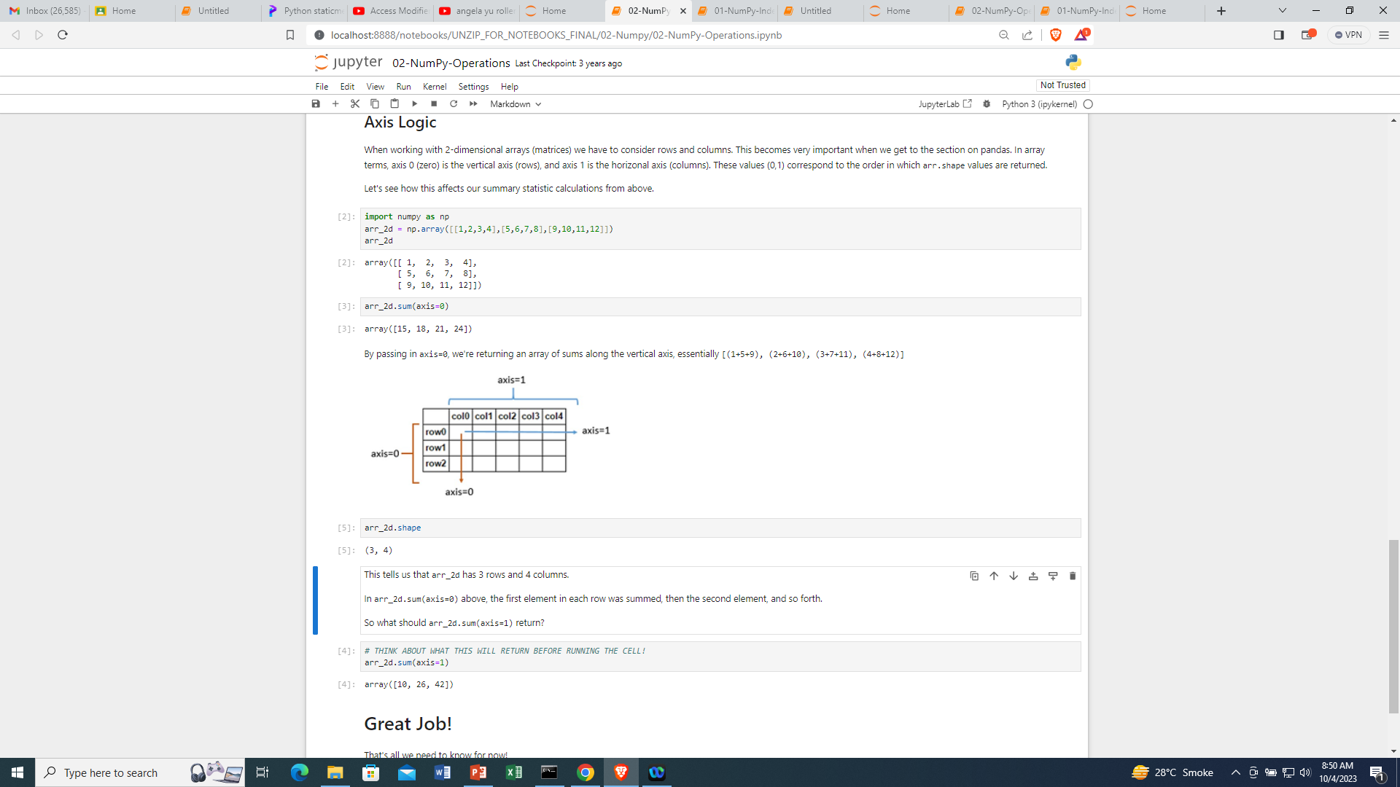

Slide 20
Exercise
Create a numpy array called myarray which consists of 101 evenly linearly spaced points between 0 and 10.

Slide 21
Use numpy to check how many rolls were greater than 2. For example if dice_rolls=[1,2,3] then the answer is
import numpy as npdice_rolls = np.array([3, 1, 5, 2, 5, 1, 1, 5, 1, 4, 2, 1, 4, 5, 3, 4, 5, 2, 4, 2, 6, 6, 3, 6, 2, 3, 5, 6, 5])

